Slide 1
Making Deep Neural Networks Robust to Label Noise: a Loss Correction Approach
Giorgio Patrini et.al, CVPR 2017 ORAL

Slide 2
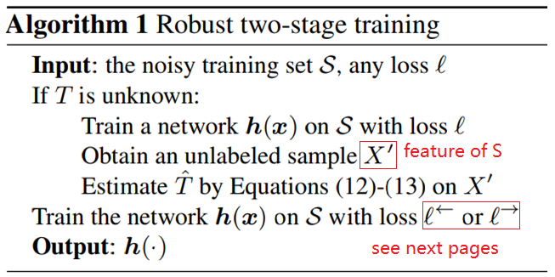
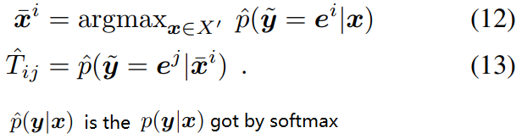
Pipeline
T is the asymmetric label transition matrix from groundtruth label to human/machine annotated label.
y is the groundtruth label and wave line y is the human or machine label.
Equation (12) means that we select the example with largest confidence in class i, i.e., the network deems that example most likely belongs to class i among all examples.
In equation (13), the T_ij is modeled as the probability of the example in equation (12) classified as class j by the network.
Continue on next page

Slide 3
Pipeline
From the algorithm, what we need is and in , so this algorithm is independent on specific network architecture.
From the paper, the is not their original work.
Equation (13) needs assumptions in Theorem 3, shown next page.
My: T_ij here is not exactly the true T_ij, because the true T_ij comes from human or other algorithm.
My: I think only equation (12) & (13) are their original work, but I won’t buy the idea.

Slide 4

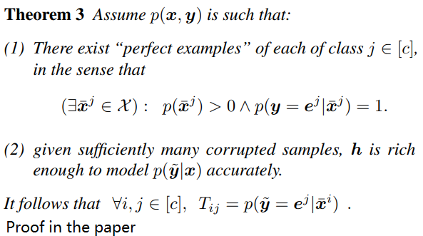
Assumptions for
Assumption (1) is very natural, that we need the example in equation (12) can be correctly classified to its groudtruth class, which is needed by equation (13).
Assumption (2) is almost the same as its conclusion ☺. I think this assumption can be got by the experiment in [1], where the labels of Imagenet are randomly changed, but the network can still get a small training error.
[1]ICLR 2017 best paper, Understanding deep learning requires rethinking generalization

Slide 5

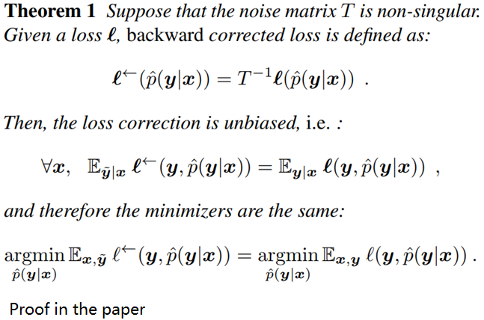


The backward correction procedure
In short: with unclean labels, the estimator is also unbiased with the first equation. This also reminds me [1].
You don’t need to understand the meaning of symbol , simply change it to everywhere.
Note the symbol under the third equation is changed to the network h in the forward correction procedure. (my: h is cropped before softmax in forward process, abusion on symbols).
My: the symbol under the third equation is the key that leads different “in short” in

Slide 6

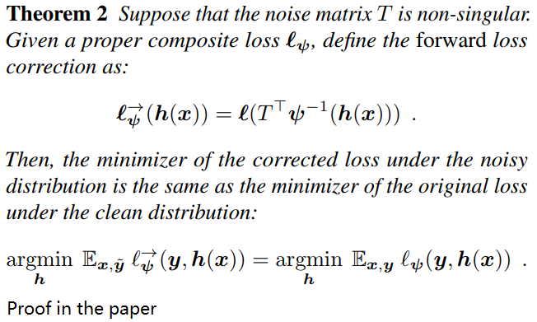

The forward correction procedure
In short: with unclean labels, the minimizer of the corrected loss under the noisy distribution is the same as the minimizer of the original loss under the clean distribution.
In the case of cross-entropy, the is softmax.
You don’t need to understand the meaning of symbol , simply change it to everywhere.

Slide 7
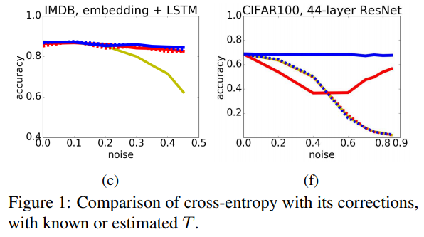
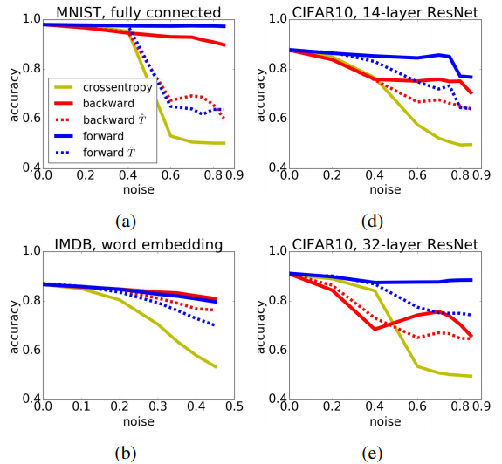
In practice
My on figure 1:
Full line: known T
Dashed line: estimated T
Yellow line: with nothing
In figure (1).c, IMDB is a dataset for sentiment analysis(NLP).
Code: There is no official code, but I found an unofficial code uploaded at March 2018 with tensorflow https://github.com/GarrettLee/label_noise_correction

Slide 8
Thinking
I think the key point of equations (12) & (13) is not good.
The idea may go further to semi-supervised, even unsupervised problems.

